Slide 1
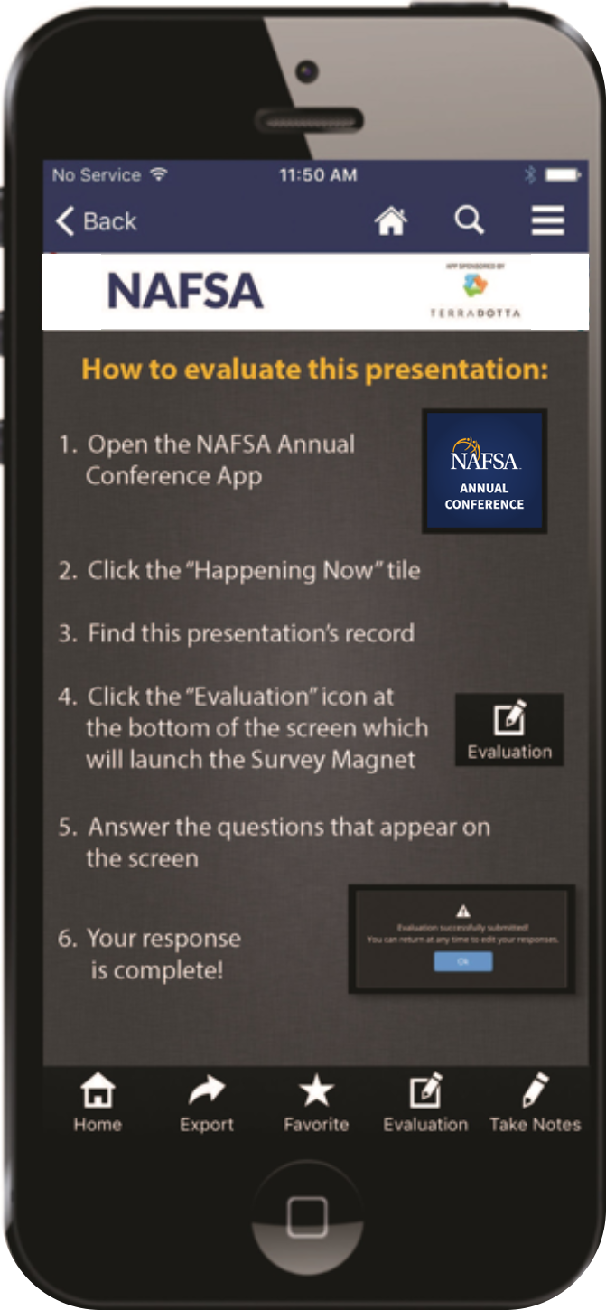
Please complete this session evaluation
NOW!
      Or FAVORITE now
      and EVALUATE later!

